Slide 1
The User Interface Architecture
October 17, 2014
Notes:
Guidewire training materials contain Guidewire proprietary information that is subject to confidentiality and non-disclosure agreements. You agree to use the information in this manual solely for the purpose of training to implement Guidewire software solutions. You also agree not to disclose the information in this manual to third parties or copy this manual without prior written consent from Guidewire. Guidewire training may be given only by Guidewire employees or certified Guidewire partners under the appropriate agreement with Guidewire.

Slide 2
User interface architecture
PCF files
Create and open PCF files
Modify PCF files
Deploy PCF files

Slide 3
Guidewire application UI framework
PCF Element
Widget
Location
Displayable elements of the user interface rendered into HTML
Navigable places in application that a user or the application itself can navigate to
The PCF (Page Configuration File) object model is a proprietary application framework used to create all Guidewire end-user interfaces
Widget and Location are high-level categories for PCF elements
Notes:
A widget is a PCF element that can be converted into HTML and displayed.
A location is a PCF element that a user (or the application itself) can navigate to. It is used to define how users move from one area of user interface to the next.
Both Widget and Location are conceptual representations in this diagram. There are no <Widget /> or <Location /> elements.

Slide 4
Atom widgets
PCF Element
Widget
Location
Atomic Widget
An atomic widget is an atomic piece of the user interface
Display individual data values
OR executes individual actions
Input
Cell
Button
Notes:
Atomic widgets are individual field items such as inputs, cells, or buttons. They will always be defined within a container widget or location.
Both Widget and Location are conceptual representations in this diagram. There are no <Widget /> or <Location /> elements. Atomic Widget is also a conceptual representation. There is no <Atomic Widget /> element.
The PCF object model is container-based. Each screen element is modeled as an object, which may contain other objects. The hierarchical structure simplifies the task of locating and modifying visual elements. Furthermore, each element can be declared as an independent and therefore reusable element.

Slide 5
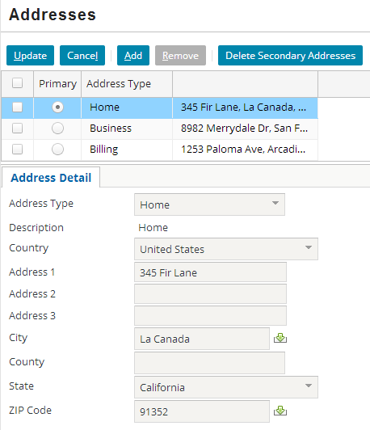
Atomic widgets: examples
Button
Cell
Input

Slide 6
Container widgets
PCF Element
Widget
Location
Atomic Widget
Container Widget
A container widget is a collection of atomic widgets and/or other container widgets
Organizes data and functionality into logical groups
Screen
Input Set
Card View Panel
Detail View Panel
List Detail Panel
List View Panel
Notes:
Container widgets hold other widgets. Each one can be defined either in its own file or as a child container within some other PCF element file.
Both Widget and Location are conceptual representations in this diagram. There are no <Widget /> or <Location /> elements. Similarly, both Atomic Widget and Container Widget are conceptual representations. There are no <Atomic Widget /> or <Container Widget /> elements.
The PCF object model is container-based. Each screen element is modeled as an object, which may contain other objects. The hierarchical structure simplifies the task of locating and modifying visual elements. Furthermore, each element can be declared as an independent and therefore reusable element.

Slide 7
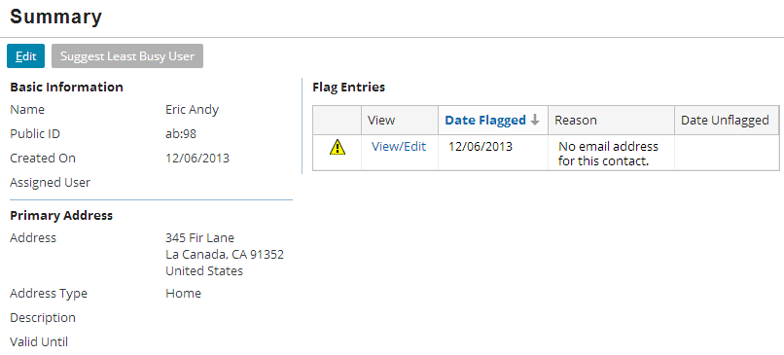
Primary views
A primary view is a reusable panel such as a detail view panel or list view panel that organizes atomic widgets.
An Input Set is a reusable collection of atomic widgets for detail view panels
Detail View Panel
List View Panel
Input Set

Slide 8
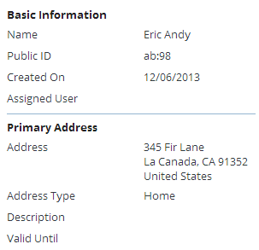
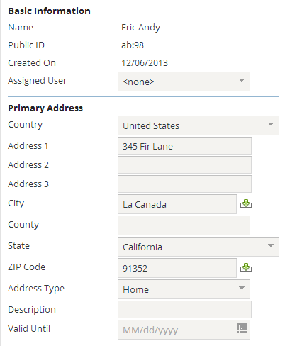
Container widgets: detail view panels
Focus on a single record
Typically, but can be more than one
Allow the user to…
View an existing record
Create a new record
Edit a record
Columns help organize atomic widgets to display a related information
Screens and secondary views can reference
Often referred to as "Detail View"
View
Edit
Notes:
Detail view panels are generally designed to use widgets to organize and manage a collection of related pieces of information that constitute a single record. The most obvious example is the set of individual fields of an instance of an entity such as User, Claim, or Policy. There are no constraints imposed by the system as to what information can be displayed by a detail view, however; the view could present information from multiple entities that do not even have to be related to one another, in addition to information that does not derive from an entity at all (such as calculated or static values).
The purpose of a detail view panel, however, and the recommended practice behind their use, is to present the user with all of the detailed information that is relevant to that interface, and no information that is irrelevant. In general this means displaying information about the fields of a particular entity and possibly fields from a small number of closely related entities.
Detail view panels must contain at least one column and can contain as many columns as necessary to present the widgets in the most effective way for the user.

Slide 9
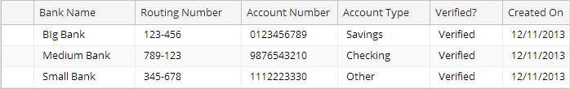
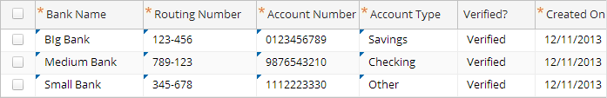
Container widgets: list view panels
View
Edit
Table organizes information that allows the user to view information about multiple records at the same time
Uses a small number of atomic widgets to display the most relevant information
Screens and secondary views can reference
Often referred to as "List View"
Notes:
Just as a detail view panel is designed to allow the user to view detailed information about a single record, a list view panel is designed to allow the user to view summary information about a collection of records.

Slide 10
Container widgets: Input Sets
Can contain atomic widgets
Can be reused by detail view panels
Cannot be referenced by secondary views
Cannot have a toolbar directly associated with them
Input Set

Slide 11
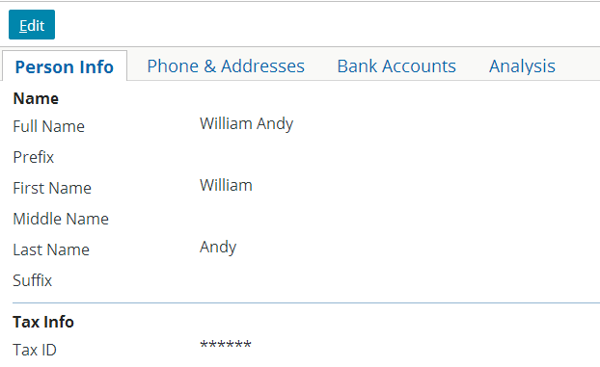
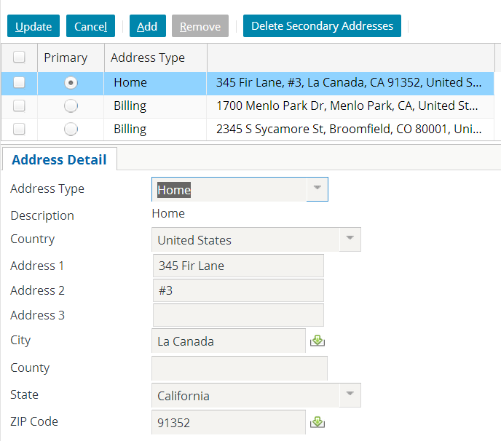
Secondary views
A secondary view organizes primary views
A Card View Panel is a collection of cards, with each card containing detail view panels or list view panels
A List Detail Panel contains a top list view panel and a bottom view panel that display data about the selected list item
Card View Panel
List Detail Panel
Notes:
A Card View Panel is often referred to as a Card View. A List Detail Panel is often referred to as a List-Detail View.

Slide 12
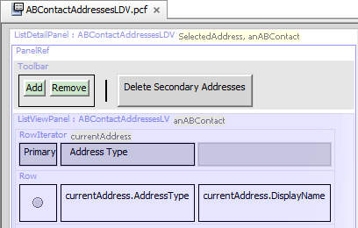
Panels
Container Widget
Card View Panel
Detail View Panel
List Detail Panel
List View Panel
A panel is a container which has a structured UI layout, shares a common placement on a PCF page, and can be rendered with a Toolbar and/or a Title bar that controls the panel behavior
Toolbar and Title bar require a containing PanelRef
Notes:
All panels share the common placement on a PCF page, for example, when defined directly on a Screen, Card, or Panel Set.
A panel and can be rendered with an associated Toolbar and/or Title Bar. Edit Buttons are typically associated with a Toolbar defined in a Screen.
Often, panels are placed within a Screen using a PanelRef widget. Although not a defining characteristic of panels, panel placement using a Panel Ref helps illustrate the distinction between primary views and secondary views.

Slide 13
Container widgets: screens
Screens are top-level containers
Every atomic widget, primary view, and secondary view is contained (directly or indirectly) in a screen
Screen

Slide 14
Container widget hierarchy
Screen
Screen
a top-level container one can navigate to
Secondary views
collections of primary views organized for usability
Primary views
a single object (and its related data) or set of objects
Atomic widgets
individual elements of data and/or functionality
Card View Panel / List Detail Panel
Detail View Panel
List View Panel
Input Set
Atomic Widgets
Notes:
Container widgets can be classified in four categories:
The lowest level is comprised of atomic widgets.
Atomic widgets can be directly contained only by primary views (detail view panels and list view panels). The purpose of a primary view is to organize atomic widgets into logical groups.
Secondary views (card view panels and list detail panels) organize primary views. Secondary views cannot directly contain most atomic widgets.
Screens are the top-level containers. Screens are used to connect what is displayed in the user interface with how users navigate through the user interface. A screen can directly contain both primary views and secondary views, but it cannot directly contain most atomic widgets.
Input sets do not readily fall into any of these categories. Input sets fit some of the attributes of primary views. They can contain atomic widgets and organize them into logical groups. Input sets cannot be referenced directly by secondary views or screens. Input set must be embedded into detail view panels and cannot have toolbars directly associated with them.

Slide 15
Locations
PCF Element
Widget
Location
Atomic Widget
Container Widget
Location Group
Page
A location is a PCF element that a user can navigate to
Define how user navigates from one UI to the next UI
Locations lesson discusses in detail
Wizard
Popup
Worksheet
Forward
Exit Point
Notes:
Both Widget and Location are conceptual representations in this diagram. There are no <Widget /> or <Location /> elements.

Slide 16
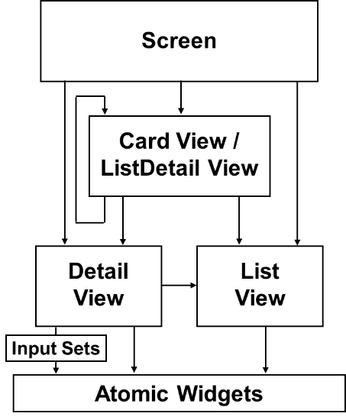
Container widgets and locations
Page
Screen
A location references a specific screen
Screens form the bridge between what the application displays and how users work and navigate in the application
Wizard
Popup
Worksheet
Card View Panel / List Detail Panel
Detail View Panel
List View Panel
Input Set
Atomic Widgets
Notes:
Notice that only a subset of locations reference screens:
LocationGroups reference a collection of Page locations, which then reference screens
Forwards redirect to any other location types, which may contain screens
Exit Points reference external URLs, which define non-application screens

Slide 17
PCF hierarchy review
PCF Element
Atomic Widget
Input
Container Widget
Cell
Button
Widget
Screen
Input Set
Card View Panel
Detail View Panel
List Detail Panel
List View Panel
Location
Location Group
Page
Wizard
Popup
Forward
Exit Point
Worksheet
Notes:
At the top level, PCF elements are split between widgets and locations. This lesson only addresses the high-level classifications of widgets (both atomic and container) and locations. Discussions of specific widgets and locations will follow in future lessons.

Slide 18
User interface architecture
PCF files
Create and open PCF files
Modify PCF files
Deploy PCF files

Slide 19
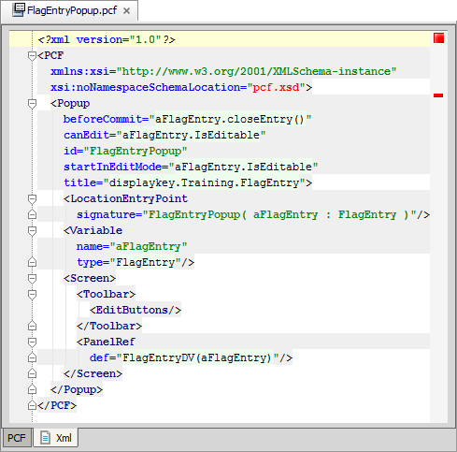
Page Configuration File (PCF)
A PCF file is an XML file that defines a location or container widget
May also:
Define child containers
Reference other containers
Include atomic widgets
Notes:
A PCF is an XSD-validated XML document containing elements that describe the structure, layout, and behavior of the web user interface. The majority of this content is defined at the application level, though some is defined at the platform level.

Slide 20
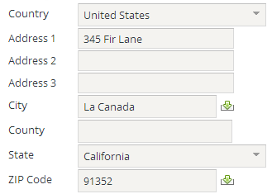
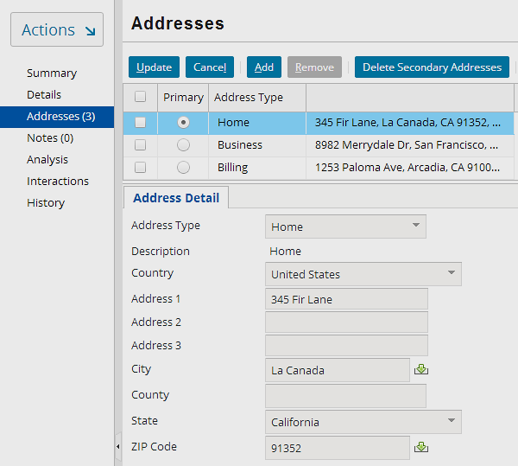
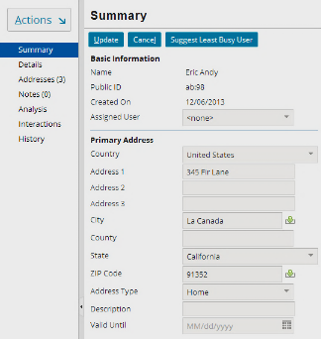
PCF files enable reusability of containers
ABContactAddressesLDV
GlobalAddressInputSet .default
ABContactSummaryDV
Notes:
GlobalAddressInputSet is a globalization input set and is modal. Modal widgets are discussed in greater detail later in this course. It is not a requirement for a PCF to be modal in order for it to be reused.

Slide 21
Valid parent objects for PCF files
PCF Element
Atomic Widget
Input
Container Widget
Cell
Button
Widget
Screen
Input Set
Card View Panel
Detail View Panel
List Detail Panel
List View Panel
Location
Location Group
Page
Wizard
Popup
Forward
Exit Point
Worksheet
Elements in blue can be a parent object in a PCF.
Notes:
Every PCF file declares either a container widget or a location. It is not possible to create a PCF file that declares only a single isolated atomic widget.

Slide 22
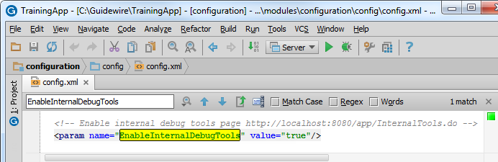
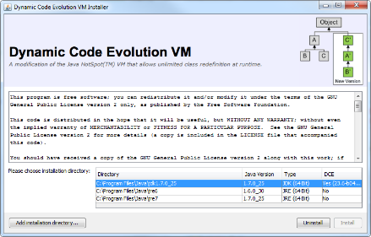
Internal Debug Tools for PCFs
config.xml parameter
EnableInternalDebugTools
value="true"
Install and enable DCEVM for JDK
Developer environments ONLY!
Notes:
You can use the internal debug tools to identify the PCF structure, associated widgets, PCF related GOSU code, and even open the PCF in Studio. It is optional to install the DCEVM for the JDK in order to use the internal debug tools.
Guidewire recommends that you install the DCEVM in development environments for a more efficient development experience. The DCEVM allows for "hot swapping" of classes. The DCEVM should NOT be installed in production environments.

Slide 23
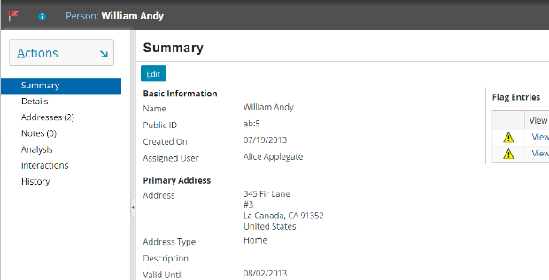
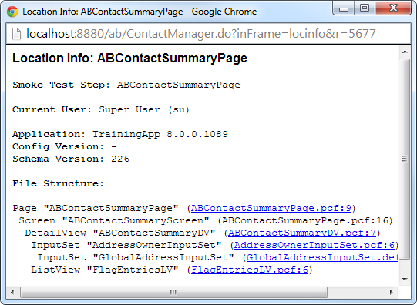
Internal debug tools: Location info ALT+SHIFT+I
ALT+SHIFT+I
Shows PCF structure and details file names
Helps identify widgets and containers
Notes:
If you are running an application project with internal tools enabled, you can view the location information with ALT+SHIFT+I in a separate browser window.
The window details the file structure and details the hierarchy of the location, screen, and any child container widgets. For each location and container widget, the name of the file in which it is referenced is listed.
Location Info is also useful when Studio is not running or if you are viewing a modal file. Location Info identifies the mode currently displayed. Going directly to the PCF editor shows you the "first" mode until you choose another.
Location Info also shows the workspace PCF if it is defined.

Slide 24
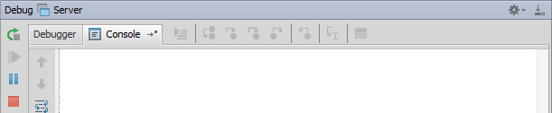
Internal debug tools: Reload PCFs ALT+SHIFT+L
ALT+SHIFT+L
2013-12-13 15:16:06,573 INFO PCFs reloaded.
Reloads all Page Configuration Files
Command window or Guidewire Studio Console window (Debug / Run) details output
Notes:
If you are running an open application project in Guidewire Studio and if internal tools are enabled, you can reload all the page configuration files and display keys for the server.
If you reload PCF files while in edit mode, you may experience unpredictable results. For the current location, where there is a data modification in progress, the new PCFs may not be reloaded. Therefore, Guidewire recommends reloading PCF files while in read-only mode as it provides for more predictable results.

Slide 25
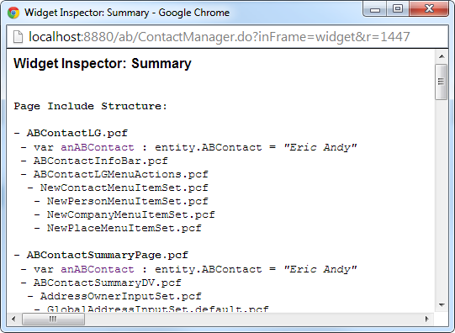
Internal debug tools: Widget Inspector ALT+SHIFT+W
ALT+SHIFT+W
Shows PCF structure and details file names
Helps identify widgets and containers
Notes:
If you are running an application project with internal tools enabled, you can view the widget information with ALT+SHIFT+W in a separate browser window.
The widget inspector shows all the PCF files and widgets referenced in the active application browser window except for the workspace area. To view the widget inspector, press ALT+SHIFT+W in the application.

Slide 26
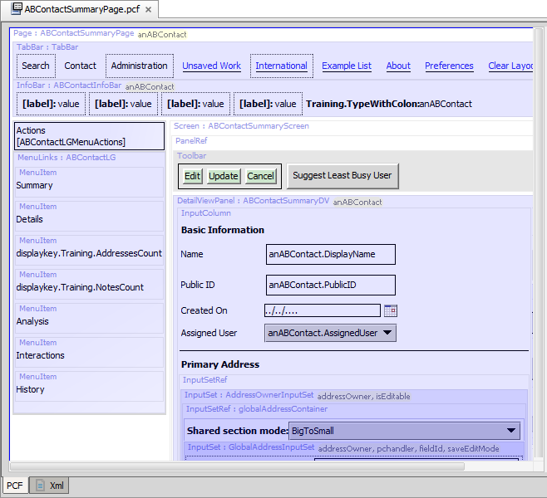
Internal debug tools: Open PCF in Studio ALT+SHIFT+E
ALT+SHIFT+E
Opens location in Studio
In Studio, navigate to container and widgets to edit
Notes:
If you are running an open application project in Guidewire Studio and if internal tools are enabled, you can automatically open the location being viewed in the application. Non-wizard locations typically reference a single screen. From the screen, you can navigate in Studio to the file you wish to edit.
This technique is useful for most UI configuration in ClaimCenter and BillingCenter, where the majority of the UI configuration is done outside of wizards.
The ALT+SHIFT+E shortcut is considered experimental. While there may be circumstances where the shortcut does not function, there should never be any negative consequences in attempting to use it.

